Slide 1
Gen DC Support User Manual

Slide 2
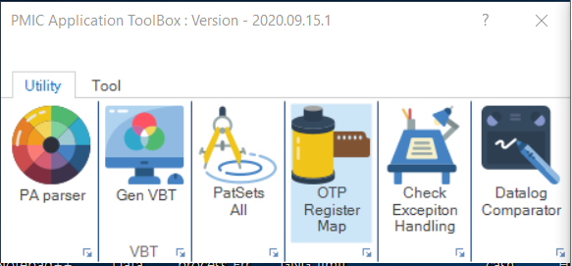
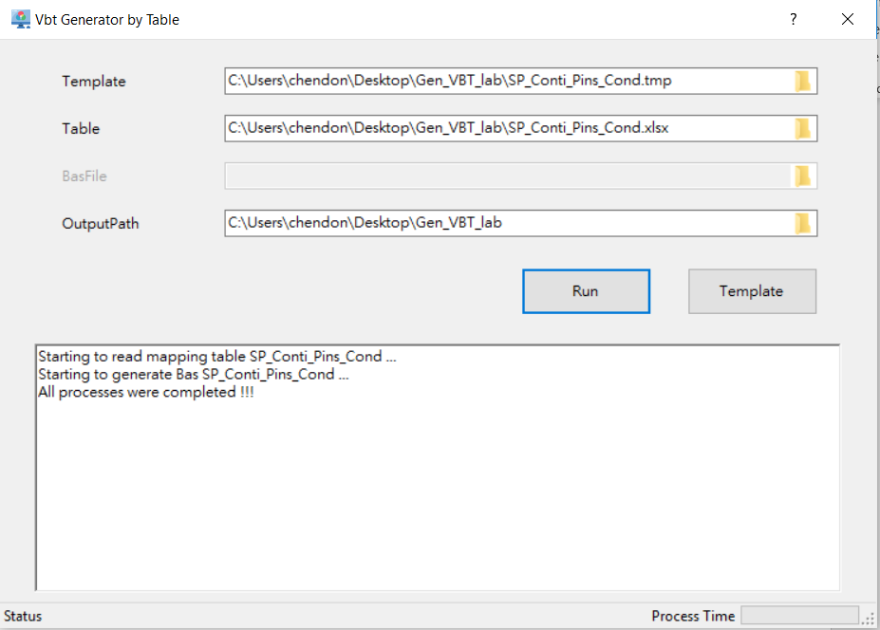
Gen VBT
Purpose
To use universal table and template to generate Bas file
GUI
Output File : Table’s file name + “.Bas”

Slide 3
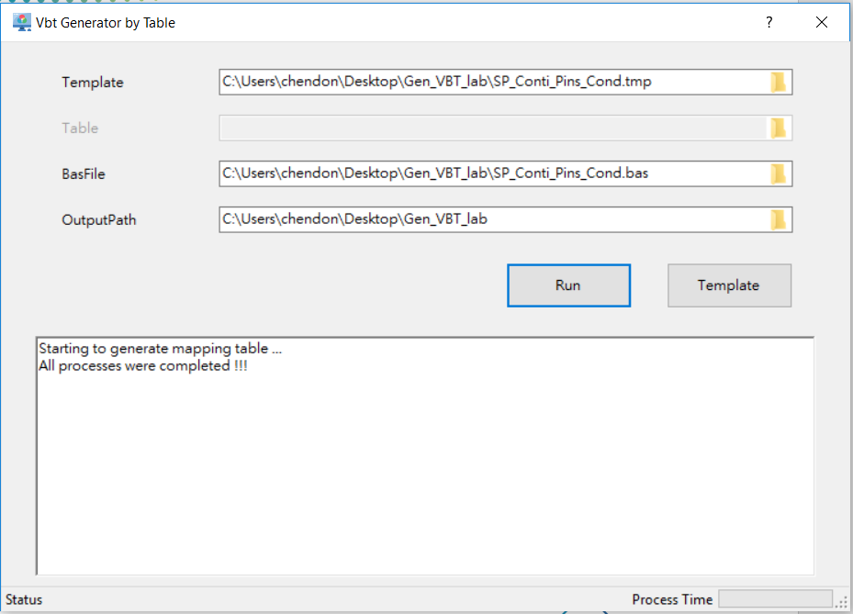
Gen VBT
Refill excel file from Bas.
-Output excel file from the .bas content

Slide 4
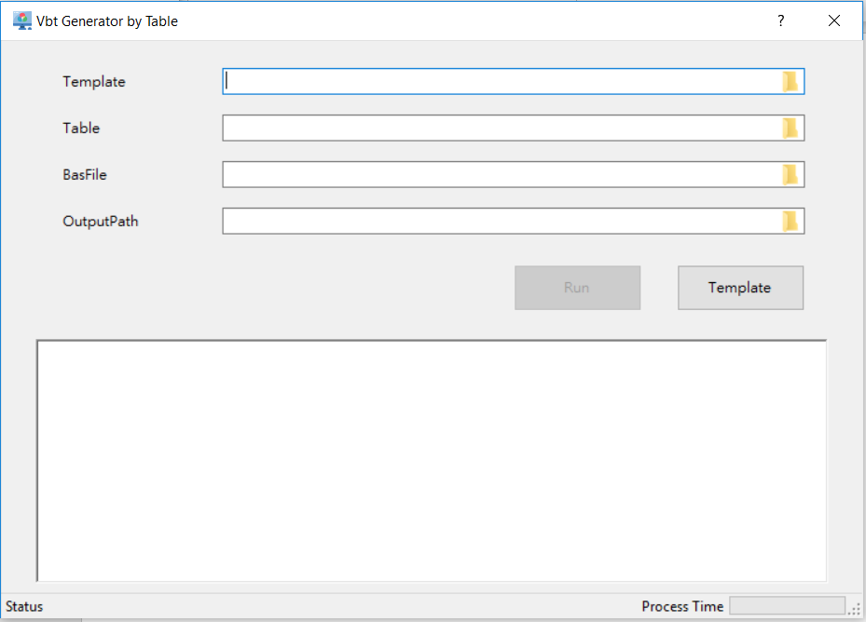
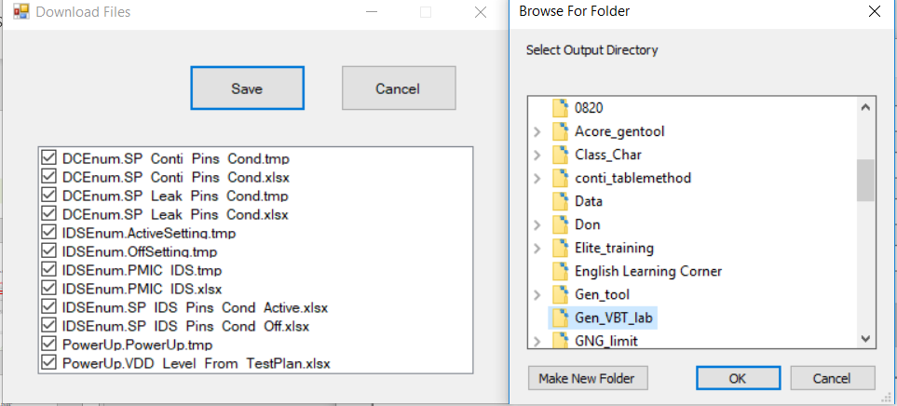
Gen VBT
Get template file
Use Template button — Chose template file and path

Slide 5
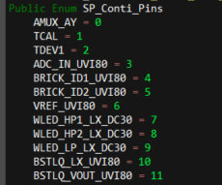
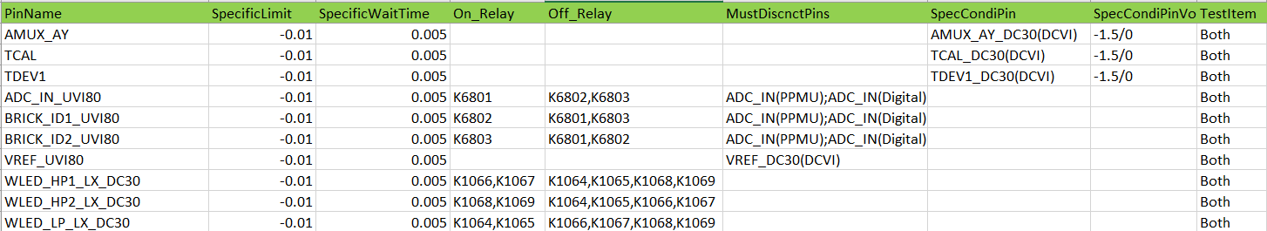
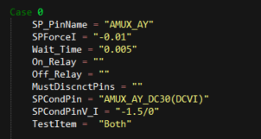
Gen VBT
Basic concept
Fill test pin in PinName column
Enum is according to table sequence in Bas.
SP_PinName is according PinName content which is test pin
SPForceI is according to SpecificLimit value which is Force I value
Wait_Time is according to SpecificWaitTime value

Slide 6
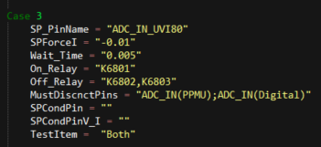
Gen VBT
Basic concept
Switch relay need to fill in On_Relay & Off_Relay
When testing disconnect pin need to fill in MustDiscnctPins
Ex.ADC_IN needs to be disconnect with PPMU and Digital when ADC_IN_UVI80 testing.

Slide 7
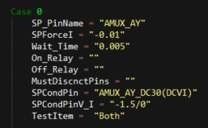
Gen VBT
Basic concept
When testing want to setup other pins need to fill SpecCondiPin and SpecCondiPinVolt_Current
E.X Setup AMUX_AY_DC30 to V = -1.5V and I =0A when AMUX_AY testing

Slide 8
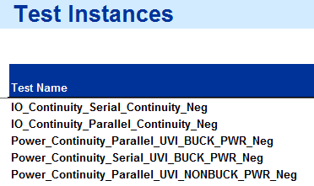
Gen VBT
Basic concept
TestItem default use “Both” or Instance tail name as setup keyword

Slide 9
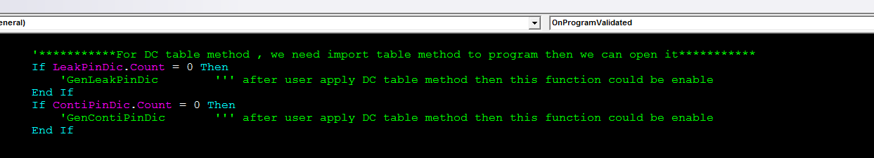
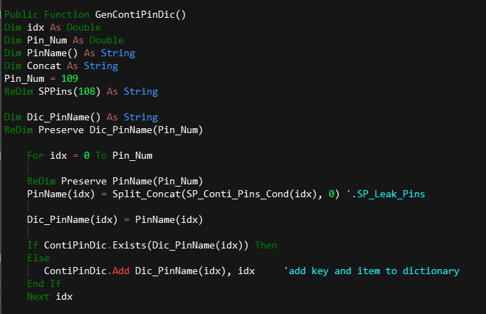
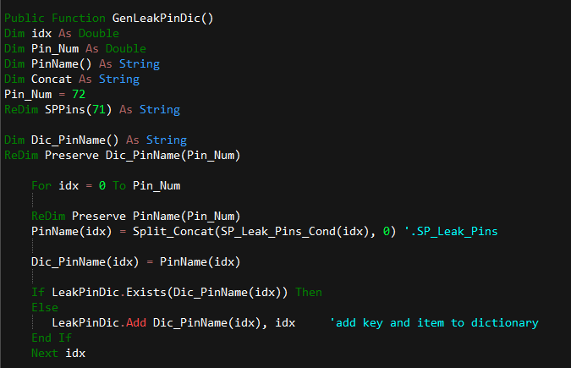
Gen VBT
Need to enable GenLeakPinDic and GenContiPinDic in OnProgramStarted and OnProgramValidated
Output file(Bas.) included GenLeakPinDic and GenContiPinDic function

Slide 10
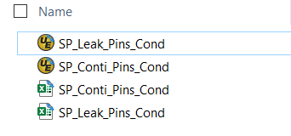
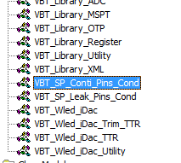
Gen VBT
Merge the output file into test program
Insert output file(Bas.) to program

Slide 11
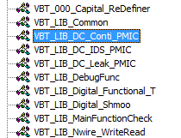
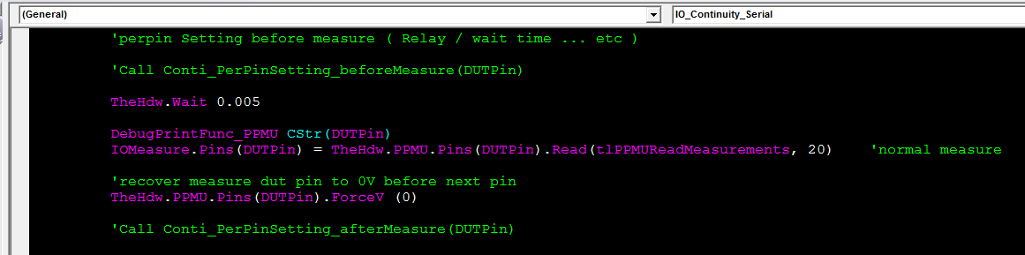
Gen VBT
Enable function in the VBT code of Conti test
Enable Conti_PerPinSetting_beforeMeasure and Conti_PerPinSetting_afterMeasure in VBT_LIB_DC_Conti_PMIC module

Slide 12
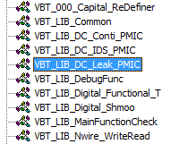
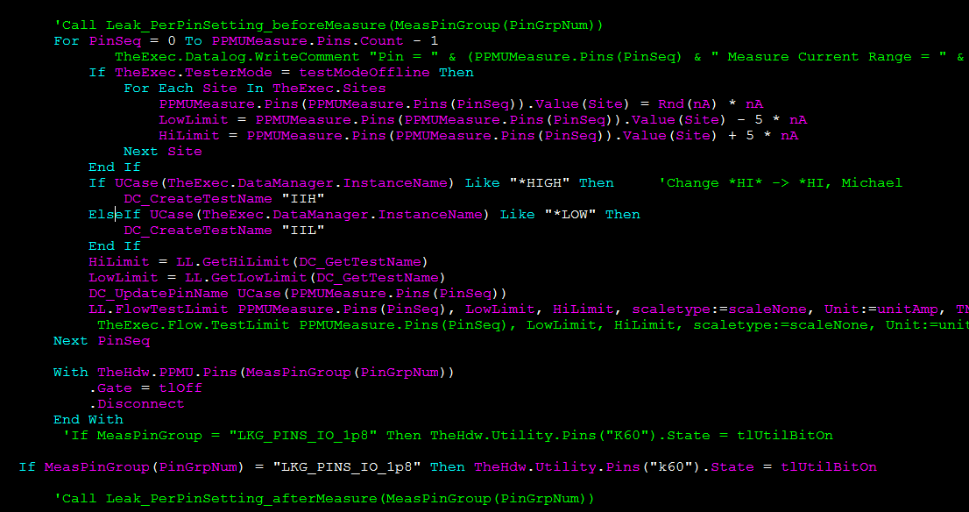
Gen VBT
Enable function in the VBT code of Leakage test
Enable Leak_PerPinSetting_beforeMeasure and Leak_PerPinSetting_afterMeasure in VBT_LIB_DC_Leak_PMIC module

Slide 13
Appendix

